Slide 1
AI IN PRACTICE 2 · MODULE 2 · THE JOURNEY
From a Notebook to a Partner's Trust
Eight weeks. Fourteen labs. The unknowns become the things you do without thinking.
Subrat Panda
5 October – 27 November 2026
Plaksha University · MS in Artificial Intelligence
Notes:
About 60 minutes, three acts: the call, the journey, the return.

Slide 2
January. A partner. An NDA. A problem in two sentences.
Nobody has solved it. The data may not leave the building.

Slide 3
What a partner will expect
1 · A signed scope | 2 · A working slice | 3 · Numbers, not adjectives | 4 · Their data rules, proven
5 · Bad news early | 6 · It runs after you leave | 7 · What it must not do | None is about the model
AI in Practice 2 · Subrat Panda

Slide 4
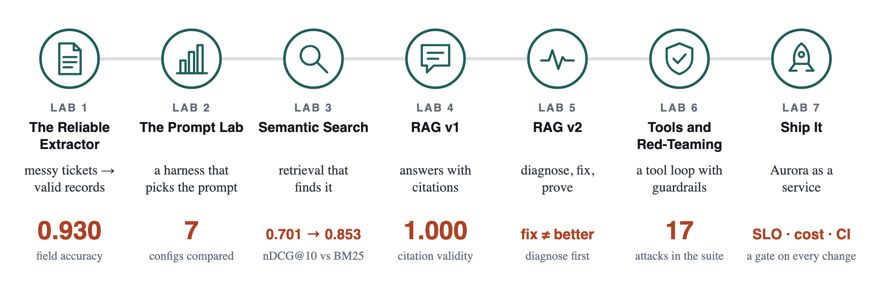
Module 1: you built Aurora
Module 1 made it work. Module 2 makes it survive: a stranger's laptop, production, a sealed building, an attacker, a client.
AI in Practice 2 · Subrat Panda

Slide 5
Who asks: further away, every arc
Labs 8–13 | Labs 14–15 | Labs 16–18 | Labs 19–21
a colleague | another company | a partner, another industry | your client
Less knowledge of your system. Less trust by default. More you must prove.
AI in Practice 2 · Subrat Panda

Slide 6
From unknown to known: 35 skills, week by week
Week | New | Becomes known
Week 1 | 10 | Git with a team: pull, conflicts, tags; One reproducible environment (containers); Rebuild a model from a clean clone; Version data and pipelines (DVC); Track experiments (MLflow); Find leakage with evidence; Choose a threshold in rupees; A typed API contract; Write a production Dockerfile; Measure latency and load
Week 2 | 4 | Work with AI coding agents, spec first; Write tests that define done; Training–serving skew; Uncertainty: the bootstrap
Week 3 | 5 | CI that rebuilds and gates the model; Canary releases and rollback; Observability: traces, metrics, dashboards; Drift, calibration and subgroup monitors; A decision in rupees, even a negative one
Week 4 | 4 | Run open models on your own hardware; Size memory, context and quantisation; Run a system sealed from the internet; Price the quality you give up
Week 5 | 4 | Publish tools as a standard (MCP); Build an agent loop, by hand and with an SDK; Humans at the gate; Evaluate agents: success, cost, variance
Week 6 | 4 | Read what the agent actually did; Attack an agent through its tools; Defend the action, in code; Scope a vague ask into a signed page
Week 7 | 2 | A working slice from a clean clone; Answer a change request with a price
Week 8 | 2 | Demo under pressure, limits included; Hand it over: runbook, ADRs, on-call
AI in Practice 2 · Subrat Panda
Notes:
The HTML deck has this as an interactive map with a week slider.

Slide 7
The prerequisites
You bring | Nobody has taught you yet, so we will
Python, virtual environments | git with a team, DVC, MLflow
ML evaluation (MLEF) | Docker, make, writing tests
LLMs, RAG, tools (concepts) | GitHub Actions, Ollama, MCP
Aurora (Module 1) | one short primer each, in docs/toolkit/
AI in Practice 2 · Subrat Panda

Slide 8
The toolkit: read before the lab
Before | Primer
Lab 8 | git & GitHub · shell · DVC & MLflow
Lab 9 | Docker, compose, make
Lab 10 | pytest
Lab 11 | statistics
Lab 12 | YAML & GitHub Actions
Lab 14 | Ollama
Lab 16 | async & MCP
Lab 19 | capstone toolchain
AI in Practice 2 · Subrat Panda

Slide 9
Four arcs
A · Ship it | Can a stranger run it?
B · Own it | Can it run with the cable pulled?
C · Let it act | Can it act safely, provably?
D · Deliver it | Can you hand it to a client?
AI in Practice 2 · Subrat Panda

Slide 10
How the labs evolve: the scaffolding comes down
Arc A | Arc B | Arc C | Arc D
most is provided | a harness | a skeleton | a starter
starter code, tests given then yours | a stack to seal and break | a server and loop with TODOs | your repo, your tests
Coding agents: by hand (Labs 8–9) → taught (10) → allowed, and you defend every line (11 on).
AI in Practice 2 · Subrat Panda

Slide 11
A
Ship it

Slide 12
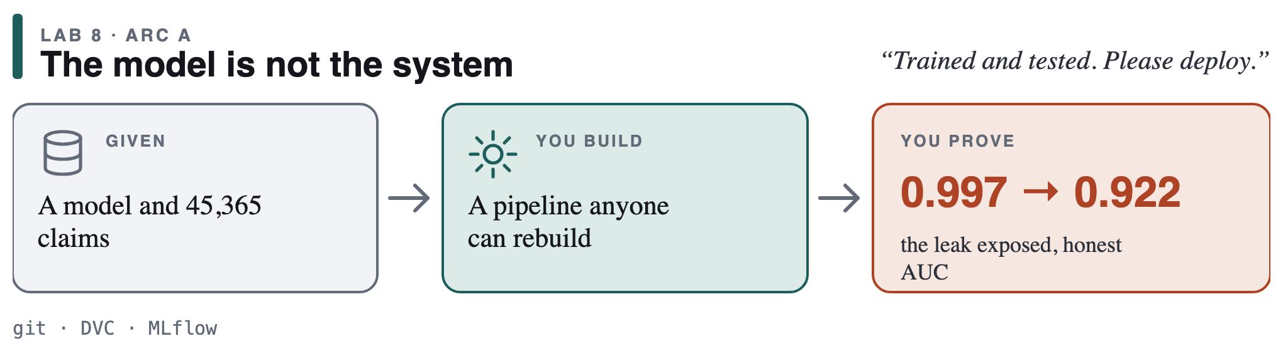
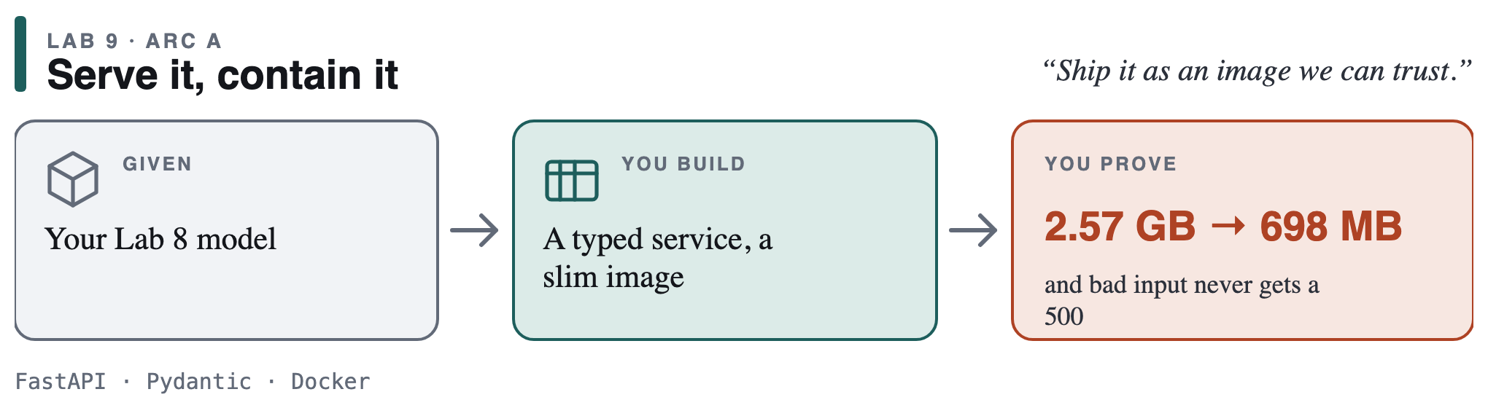
Week 1
AI in Practice 2 · Subrat Panda

Slide 13
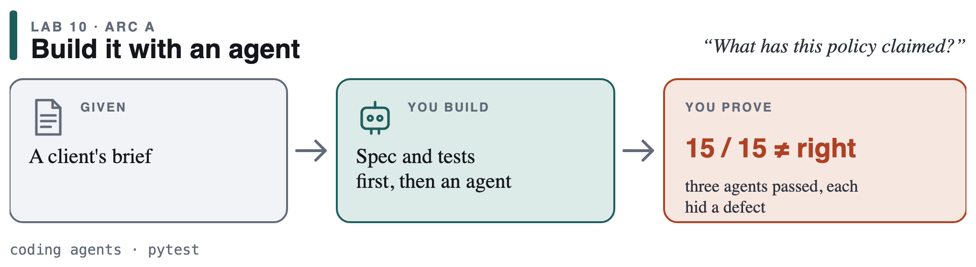
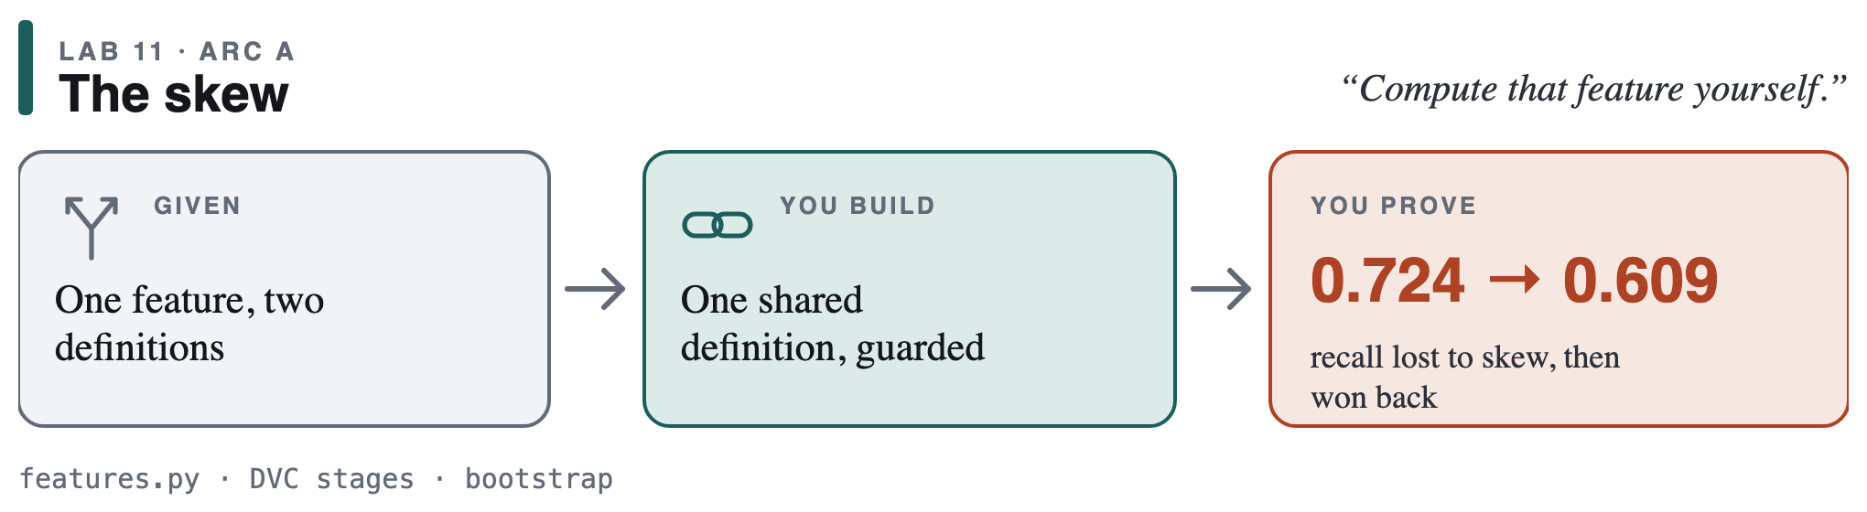
Week 2
AI in Practice 2 · Subrat Panda

Slide 14
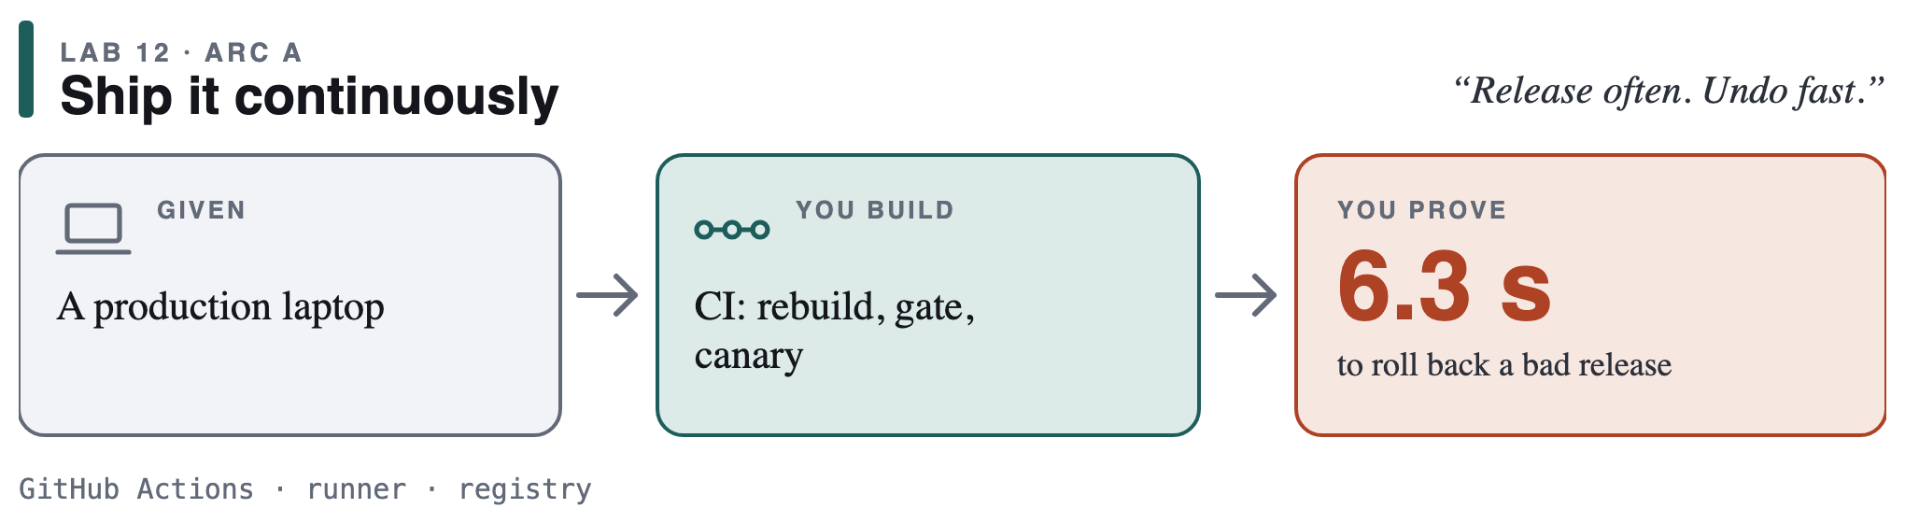
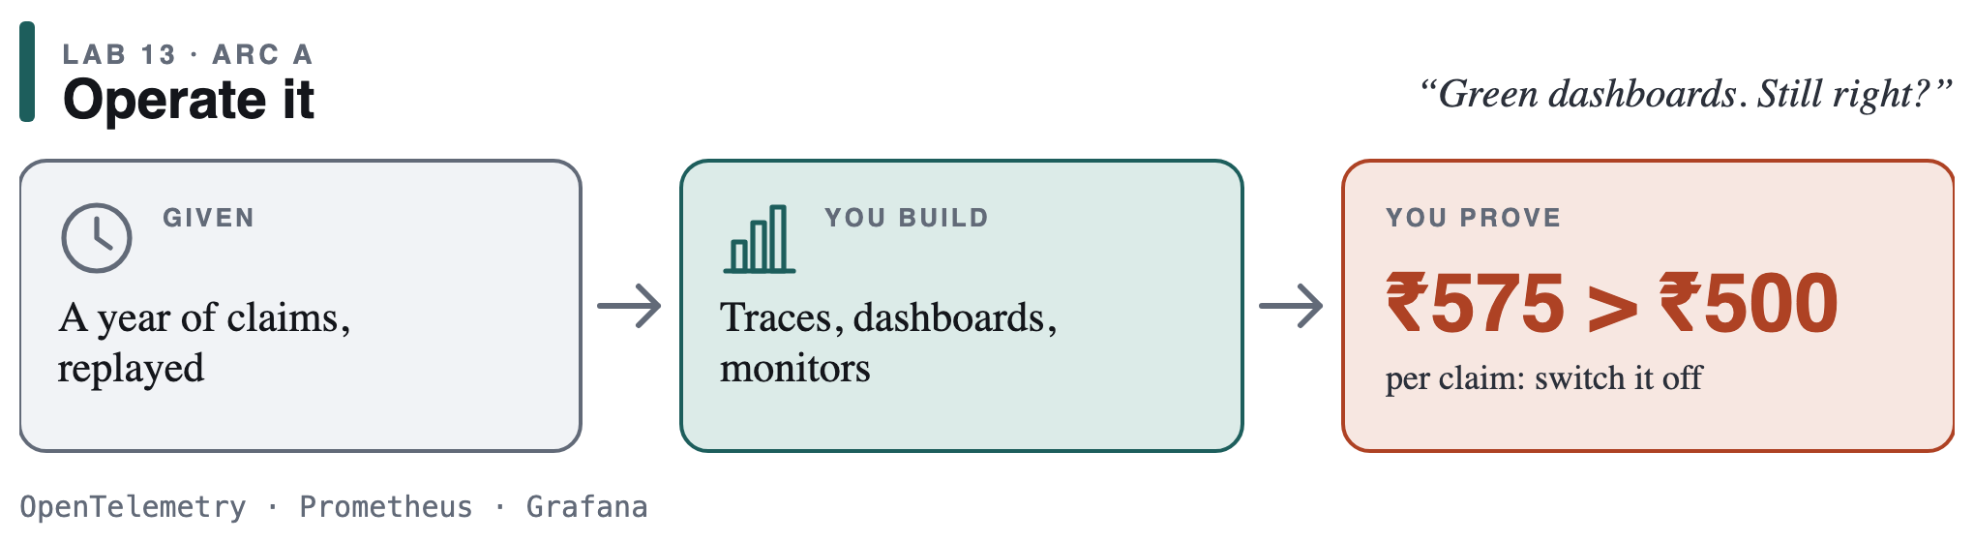
Week 3
AI in Practice 2 · Subrat Panda

Slide 15
The honest number keeps shrinking
The card implied | Honest, in rupees | Skew fixed | A year live
~88% | 14% | 6.6% | off (≈ ₹575 vs ₹500)
Found in a lab: a week. Found in production: real money. Honest negative results score full marks.
AI in Practice 2 · Subrat Panda

Slide 16
B
Own it

Slide 17
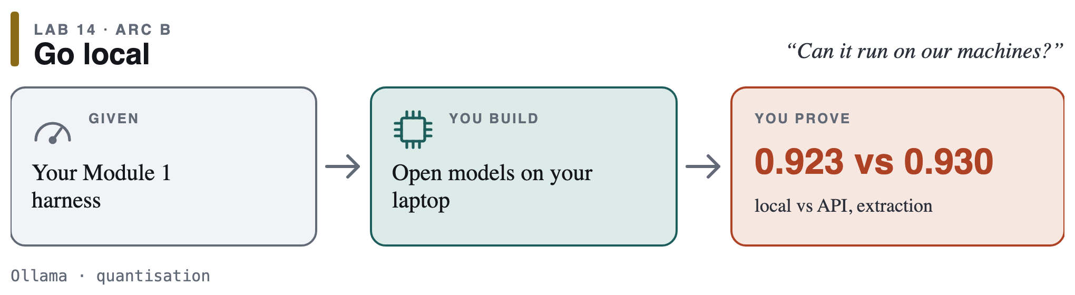
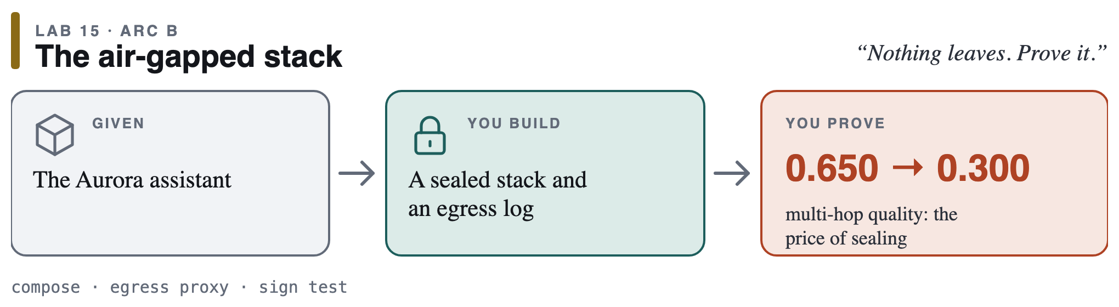
Week 4
AI in Practice 2 · Subrat Panda

Slide 18
C
Let it act

Slide 19
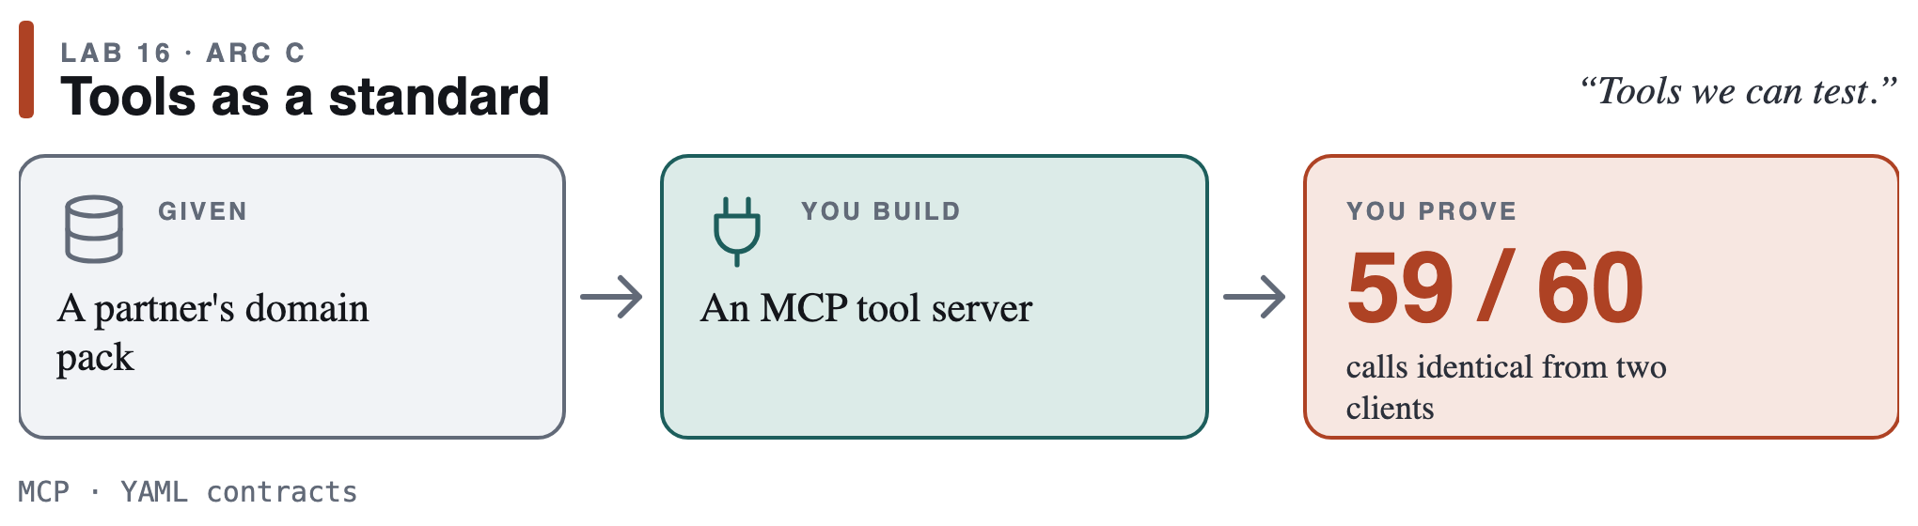
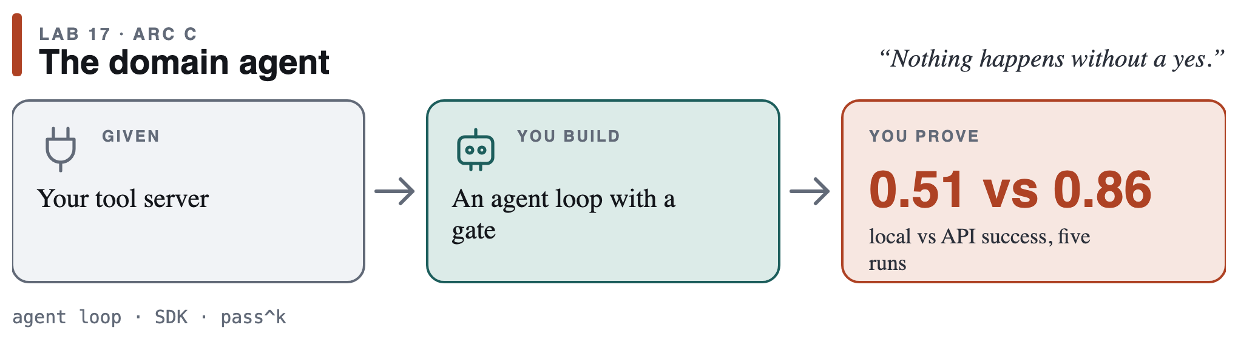
Week 5
AI in Practice 2 · Subrat Panda

Slide 20
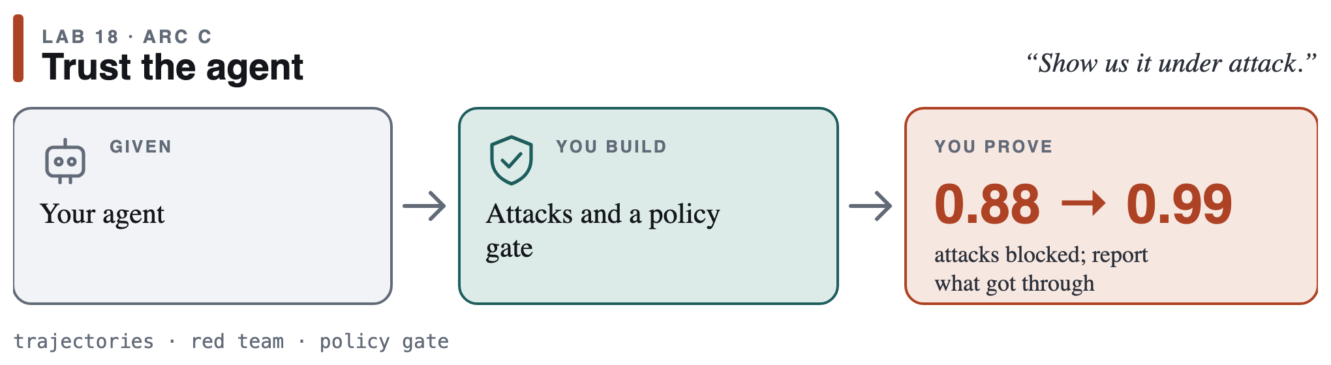
Week 6
Defend the action, not the prompt.
AI in Practice 2 · Subrat Panda

Slide 21
D
Deliver it

Slide 22
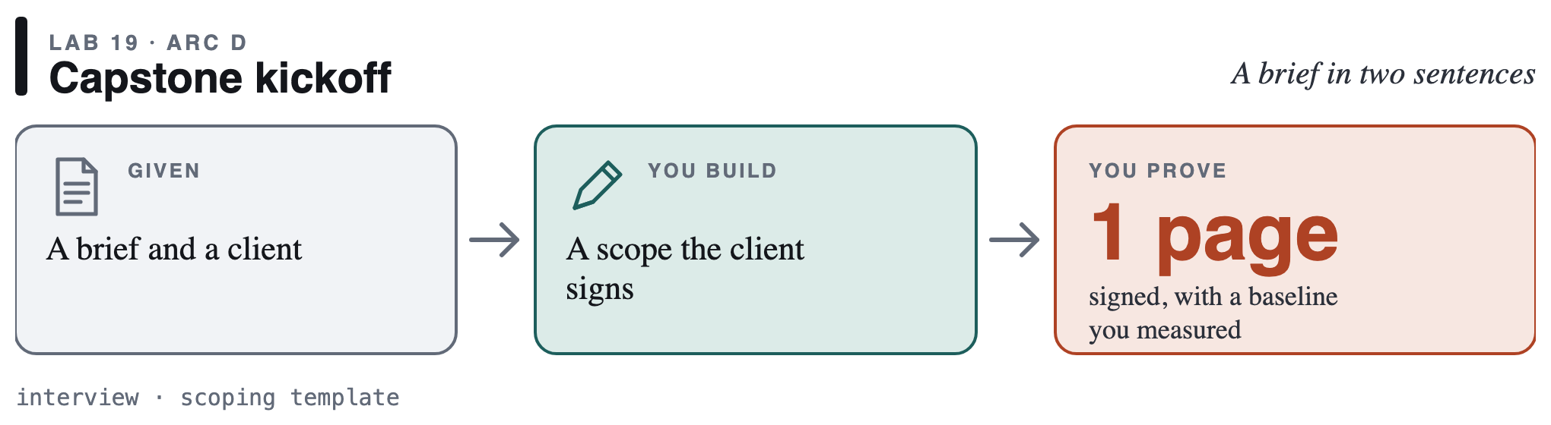
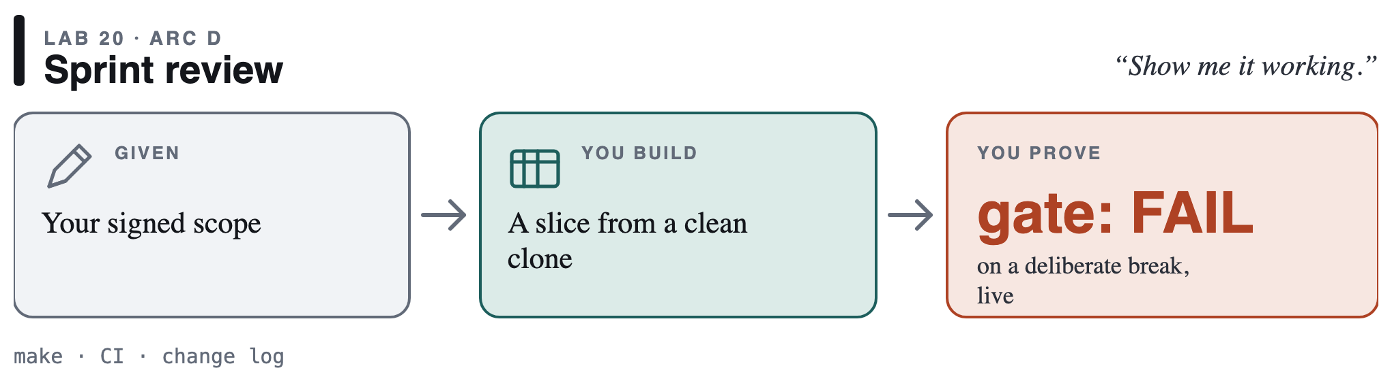
Weeks 6–7
AI in Practice 2 · Subrat Panda

Slide 23
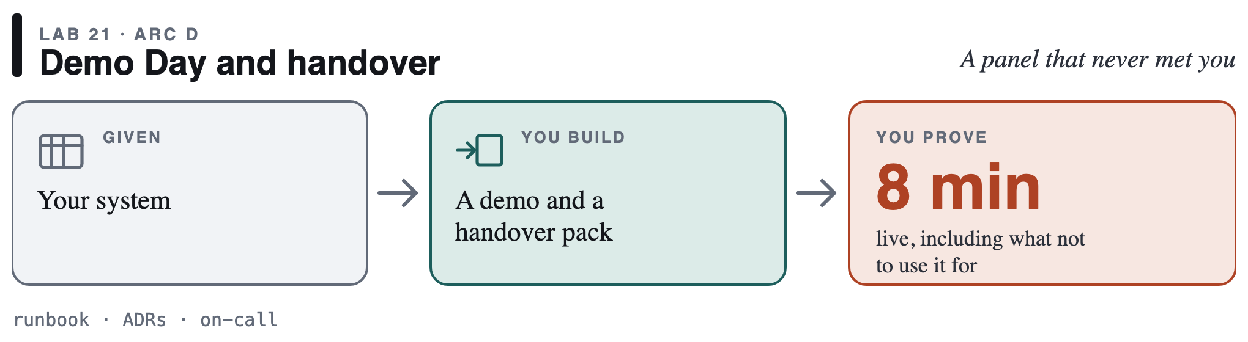
Week 8
Graded on Demo Day: what you would not deploy this for.
AI in Practice 2 · Subrat Panda

Slide 24
January again. Your second time.

Slide 25
Every expectation, already rehearsed
Signed scope · Lab 19 | Working slice · Lab 20 | Numbers · every lab | Data rules · Lab 15
Bad news early · Lab 13 | Runs after you leave · Labs 8, 12, 21 | What it must not do · Lab 21 | January, rehearsed
AI in Practice 2 · Subrat Panda

Slide 26
What changes in you
Week 0 | Week 8
"It works on my laptop" | A clean clone agrees
"Accuracy is high" | It saves this many rupees, or not
"The agent did it" | The ledger shows what it did
"It's local, so it's safe" | The egress log shows nothing left
AI in Practice 2 · Subrat Panda

Slide 27
The habits that travel
No number, no claim | Somebody else can run it | Watch it fail first
Evidence, not summaries | Rupees, not accuracy | Rules in code, humans at the gate
AI in Practice 2 · Subrat Panda

Slide 28
Every week
Before | 20-min briefing | 3-hour lab | After
primer · setup · notes | data · code · assignment | team of three · RUNSHEET | quiz · tagged commit
Labs 8–18 44% · scoping 6% · system 20% · report and Demo Day 20% · practice 10%
AI in Practice 2 · Subrat Panda

Slide 29
This week
1 | 2 | 3 | 4 | 5
Read the story (docs/THE_STORY.md) | make up, make check | Three primers: git · shell · DVC | Team repo, three laptops | One question for the Lab 8 briefing
AI in Practice 2 · Subrat Panda

Slide 30
In eight weeks, the unknowns on that map are habits.
So January is your second time.

